Slide 1
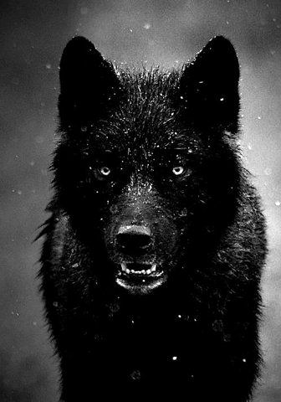
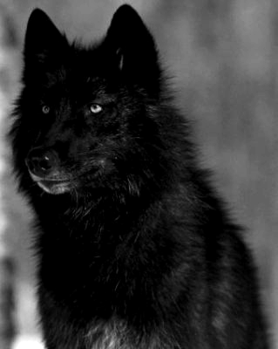
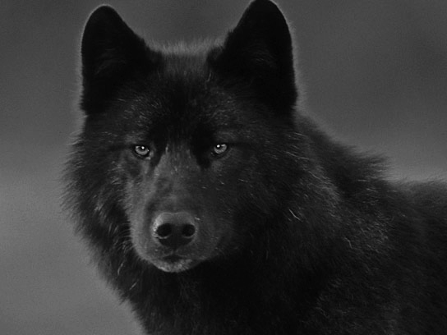
BLACK WOLVES
Mary Correa Ortega & Alvin Dai
& Victor Cherres

Slide 2


Journey to Paradise

Slide 3


Slide 4


Slide 5


Slide 6


Slide 7


Slide 8


Slide 9


